Slide 1


Extreme Earth Events
By: Ngaatendwe Wish Dumbarimwe
Grambling State University
FIREBALLS.csv

Slide 2
Table of contents
01
02
03
04
05
Methods/ Results
Introduction
Hypothesis
Background & Significance of Research
Research Question & Hypothesis
Visualizations, Graphs, & Statistics
Conclusion
References
Conclusion, Takeaways
References

Slide 3
Background
A fireball is another term for a very bright meteor, generally brighter than magnitude -4, which is about the same magnitude of the planet Venus in the morning or evening sky.
In this presentation I will be looking at the component velocities of a fireball and how they contribute toward the resultant velocity.
Interesting fact: Meteors enter our atmosphere everyday but mostly go unidentified.

Slide 4
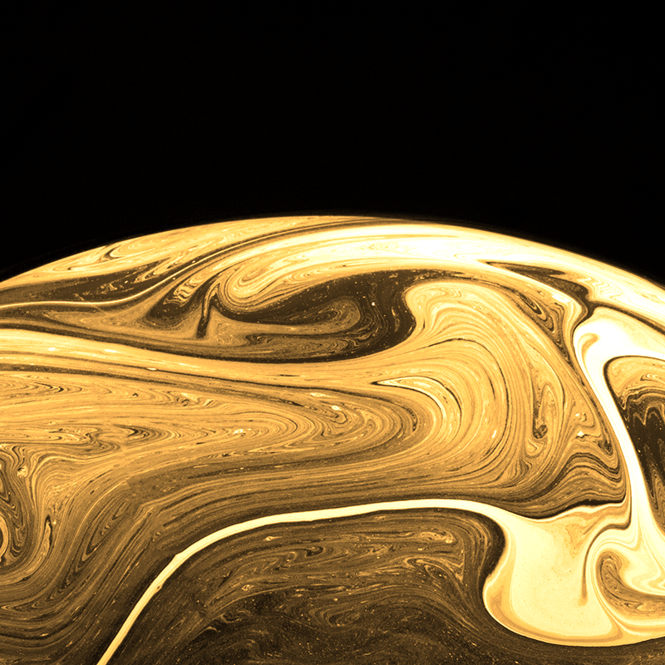

Significance of Research
1. Trajectory Prediction
2. Blast Wave Impact
3. Fragmentation Risks
4. Sonic Boom Effects
Overall understanding of the component velocities of a fireball provides a more nuanced picture of its potential impact on humans. It allows scientists to make more precise assessments of risks and take appropriate mitigation measures.

Slide 5
Research Question:
How do the vector velocities of a fireball contribute to the final velocity?
Hypothesis:
Component velocities contribute equally to the velocity of a fireball.

Slide 6
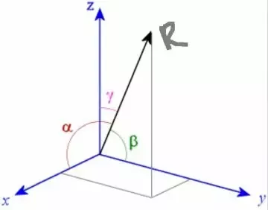
Methods
I used a heatmap to show the correlation, r of the component velocities with the resultant velocity.
For this problem I cleaned the data and I used scatter plots with linear regression to analyse the relationship between the component velocities and the resultant velocity. (using python)
I also used a t-test and p-values to determine the significance of the relationship.
https://images.app.goo.gl/9Ctwg9wUeWzSu3JUA

Slide 7
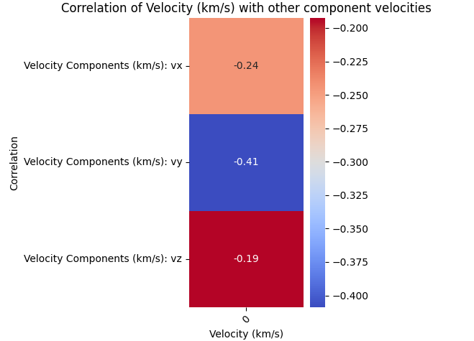
Results

Slide 8
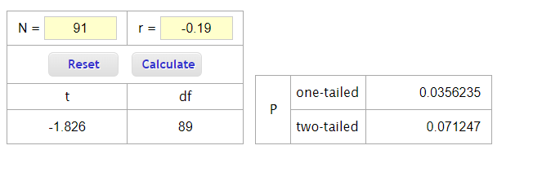
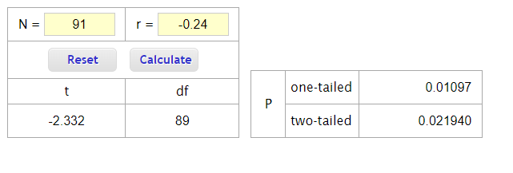
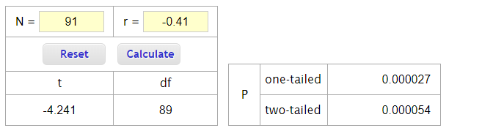
T-test/p-values (using vassarstats.com calculator)
Z-component
X-component
y-component
Key
t : T-test value
df: degrees of freedom
P: p values
N: samples
r: correlation

Slide 9
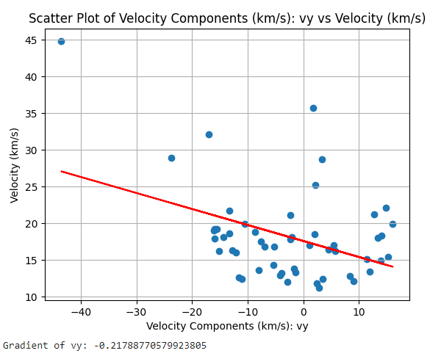
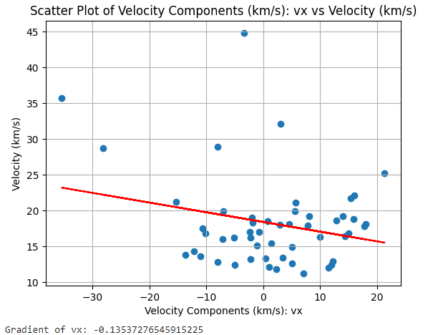
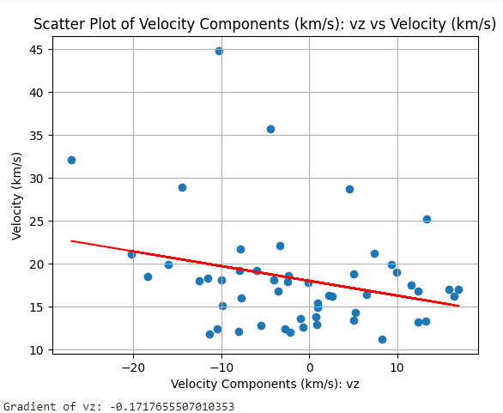
Scatter Plot for each component velocity
*Some values of velocity(km/s) were missing and were calculated using the formula (x^2)+(y^2)+(z^2)

Slide 10
Conclusion
In conclusion my hypothesis was not supported, the results showed that the y-component has a greater relationship to the velocity compared to the other two component velocities and is likely to have a greater impact on the velocity.

Slide 11
Future Studies
Considering the results it would be more reasonable for scientists to focus more on the y-component of the velocity since it has a more clear and significant relationship with the velocity.

Slide 12
References
Santiago E., Fireball or contrail? American Meteor Society, https://www.amsmeteors.org/fireballs/fireball-or-contrail/.
Drolshagen, E., Ott, T., Koschny, D., Drolshagen, G., Schmidt, A. K., & Poppe, B. (2020). Velocity distribution of larger meteoroids and small asteroids impacting Earth. Planetary and Space Science, 184, 104869.
Cooke, B., Brown, P., Blaauw, R., Kingery, A., & Moser, D. (2015, April). When the Sky Falls: Performing Initial Assessments of Bright Atmospheric Events. In IAA Planetary Defense Conference (No. M15-4455).
Image of vector forces, https://images.app.goo.gl/9Ctwg9wUeWzSu3JUA
Gemini ai, https://g.co/gemini/share/bedc92453ea9

Slide 13
Acknowledgements
Dr. Patrycja Krakowiak
Dr. Whitney Holden
Jennifer Fowler
Teressa Valdivia
Arkansas Summer Research Institute

Slide 14
Thank you!
Do you have any questions?
dumbarimwengaatendwe@gmail.com
+1 (318) 245 2478

